Slide 1


Power BI Report: HR Report
Nikhil Kuber Mankapure
nikhil.mankapure.tech@gmail.com
https://github.com/NikhilMankapure/HR-Management-Project.git

Slide 2
Executive Summary:
Introduction: AltiQ Technologies is a software and data solution company And They need insights from the HR data to have conclusions related to the presence of staff on a daily basis and also the schedule of work from home of the staff. They have provided us with the input data for three months and have shown their interest in getting build a interactive report dashboard.
Problems
Presence Tracking
Work From Home schedule
Sick Leave trends
Other inferences

Slide 3
Methodology
Excel File Exploration
Excel File insights
Preparing data for dashboard
Building a template and a FUNC
Dash-Board Building in Power BI
Attendance Insights

Slide 4
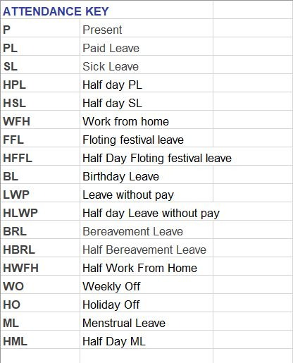
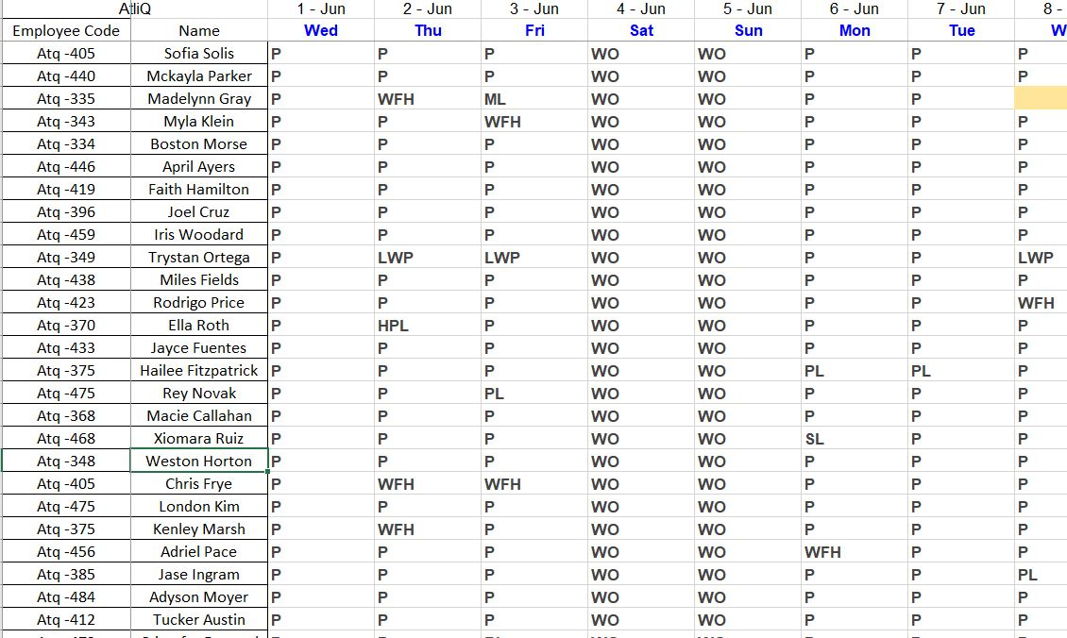
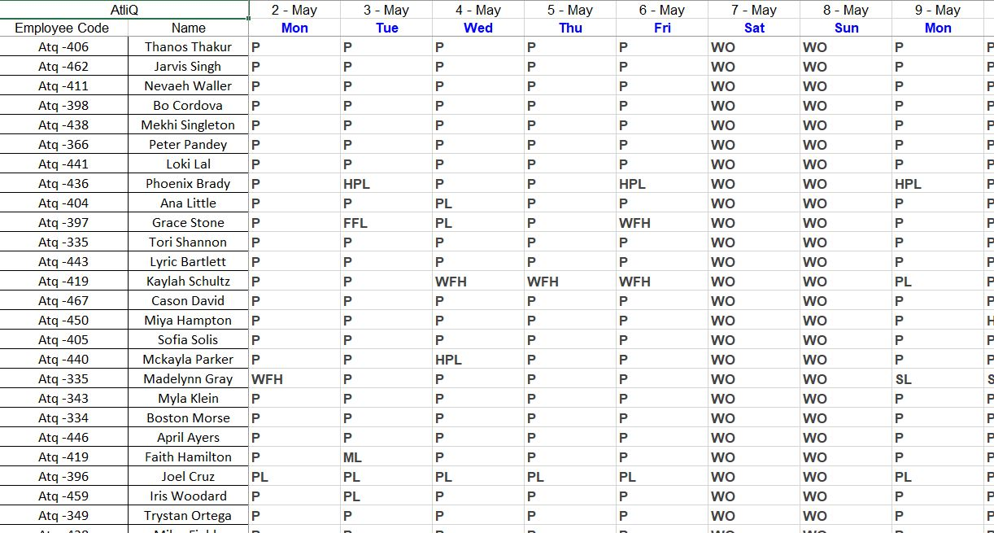
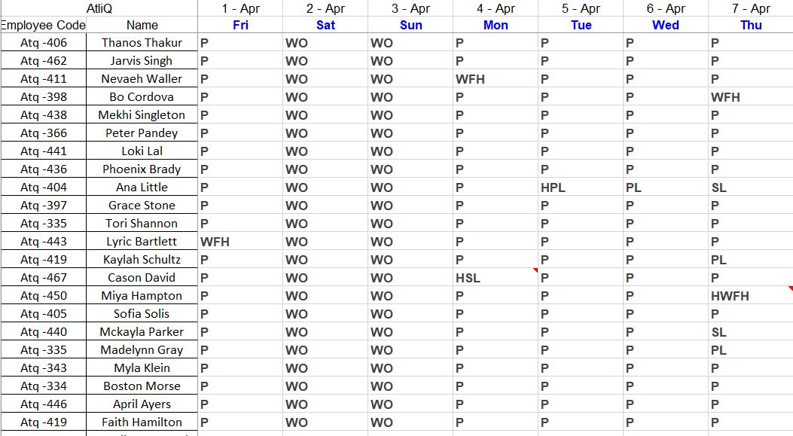
Excel File Exploration
Steps to Explore excel file.
Go through all the provided sheets and the data types and format of data and identify the possibilities of data transformation techniques.
Draw Conclusions on what basis the data is to be transformed to reach the ultimate goal.

Slide 5
Excel File insights
The table contains dates in a horizontal form and it would be difficult to build a template using such a table so we need to transform it into transpose to take all dates in vertical form.

Slide 6
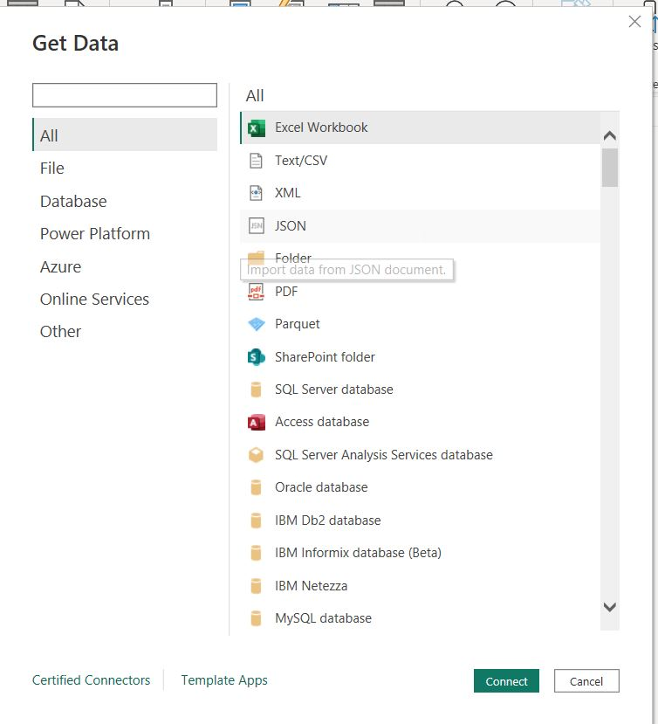
Connecting Excel File to Power BI
From the GET DATA option in the home tab in Power BI we import the data from Excel-Workbook by connecting the excel file using the specified location of the file.

Slide 7
Building a template and a FUNC
Opened the Excel file in Power Query tab.
Created a duplicate copy of the sheet.
Renamed it as template file.
Selecting data from one month we transform it to apply the changes in a sequential form and by creating a parameter we convert the template as a function with name GetData.
Now we apply the formula GetData to the other month data file so that the same sequence of steps is applied to the other month data automatically
So the learning curve for the adaptation to the new dashboard system automatically reduces as they need not make any changes to the record keeping technique which they have been following.

Slide 8
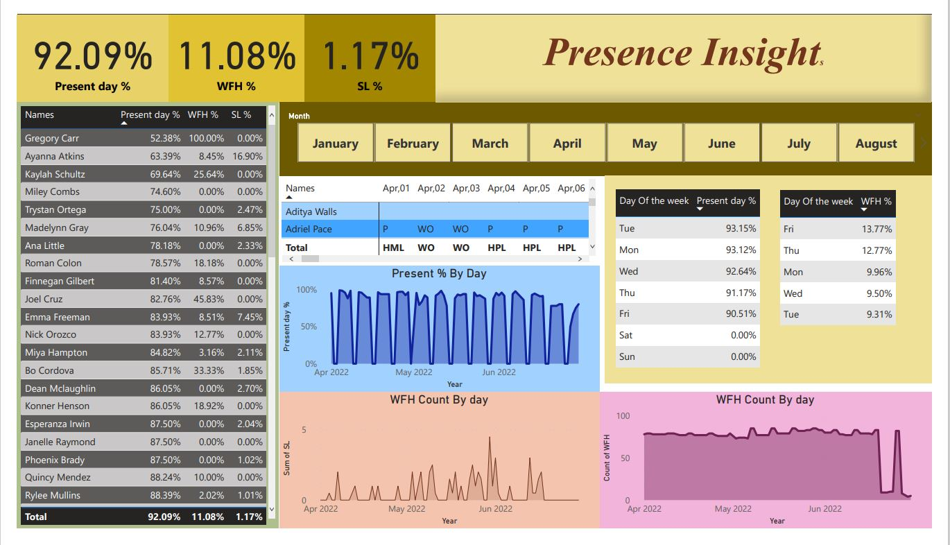
Dash Board Building
Dash Board requires some elements at its core: Present Percentage, Sick Leave percentage, Work From home percentage.

Slide 9
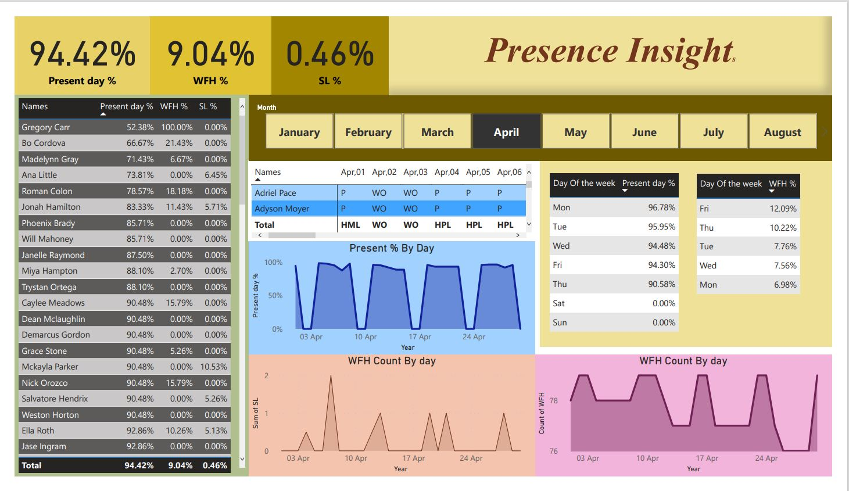
Dash Board Building
Dash Board with the data corresponding to the month of April. The days on which the max people attend office offline are Monday and Tuesday and choose work from home on Fridays and Thursdays.

Slide 10
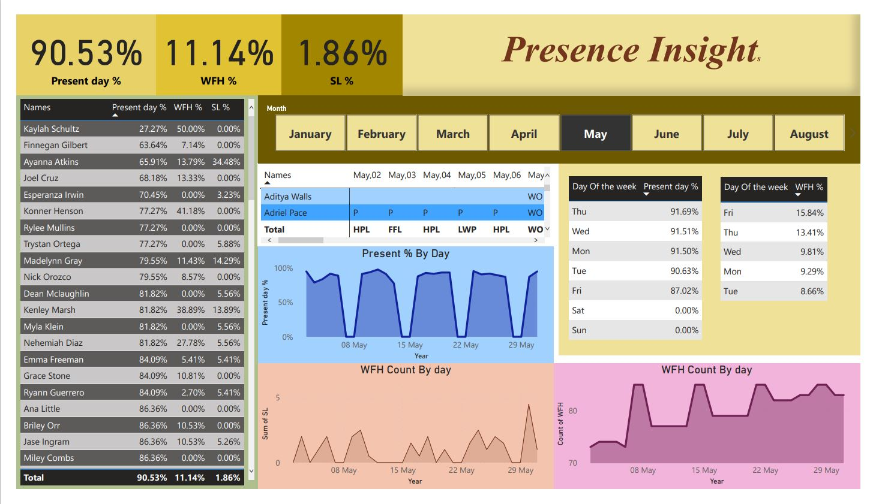
Dash Board Building
Dash Board with the data corresponding to the month of May. The days on which the max people attend office offline are Monday and Tuesday and choose work from home on Fridays and Thursdays.

Slide 11
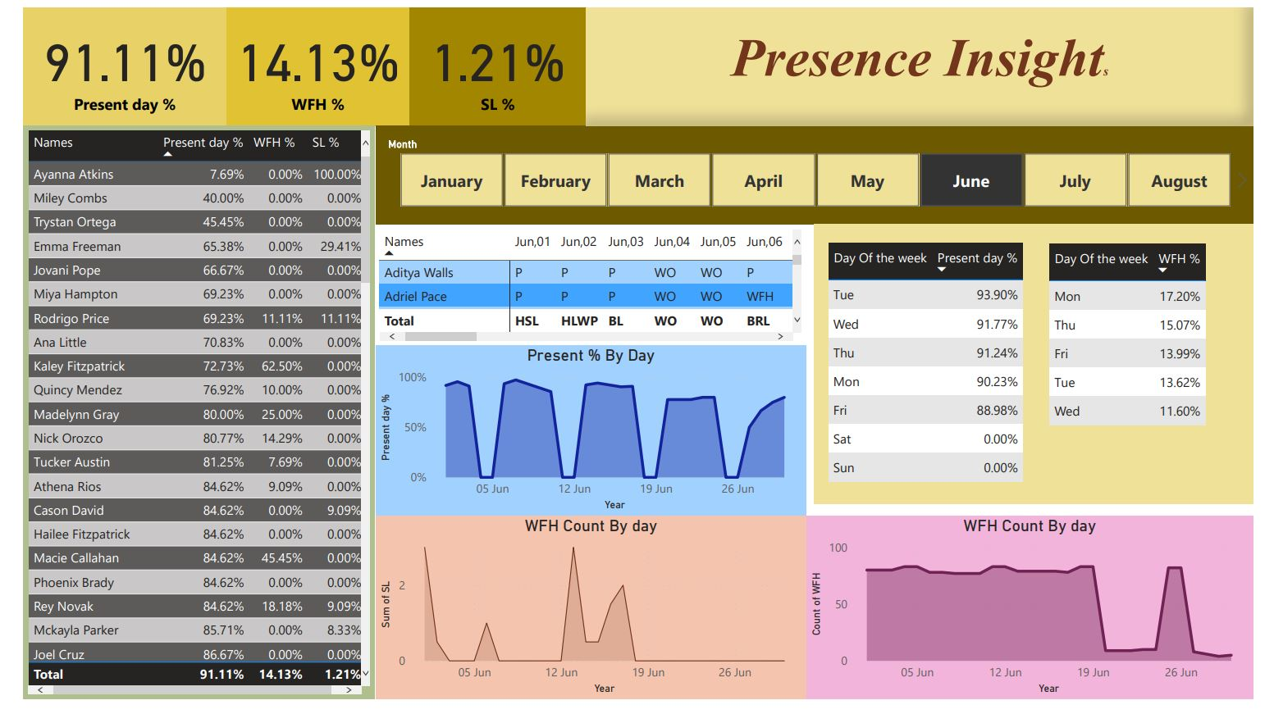
Dash Board Building
Dash Board with the data corresponding to the month of June. The days on which the max people attend office offline are Tuesday and Monday and choose work from home on next day of Sunday i.e. Monday.

Slide 12
Conclusion:
The days those were chosen for work from home by the employees is mostly Friday and Thursdays which gives us the idea that they tend to get work from home schedules in continuation of the weekly off and has formed an habit among the employees.
To conduct the weekly and monthly meeting for follow up the days which are most eligible are Monday and Tuesday with maximum presence of the employees on these days.
April shows the maximum present percentage giving us the indication that in april the employees tend to be regular without any extra leave.
Whereas in month of May which is basically the end of academic year and the month of summer break employees tend to take leave with the minimum present percentage, thus having this insight we have an idea that more number of projects cannot be handled in this month when compared to April.
There are enormous insights those can be drawn using this interactive dashboard.

Slide 13
THANK YOU
Special Thanks To Codebasics: DataAnalysisProjects/1_SalesInsights at master · codebasics/DataAnalysisProjects (github.com)
For providing with the files for the analysis and guiding me through the project.

